Slide 1
Heavy Smoking and Liver
By
Ahmed Abudeif Abd Elaal
Resident in Tropical Medicine & Gastroenterology Department

Slide 2
Introduction

Slide 3
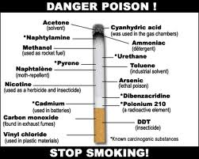
Cigarette smoke contains over 4,700 chemical compounds including 60 known carcinogens with hazardous adverse effects on almost every organ in the body.

Slide 4
Common constituents of cigarette smoke
The constituents of smoke are contained in either the particulate phase or gas phase.
Particulate phase:
Components include tar, polynuclear hydrocarbons, phynol, cresol, catechol, trace elements, nicotine, indole, carbazole, and 4-aminobiphenyl.

Slide 5
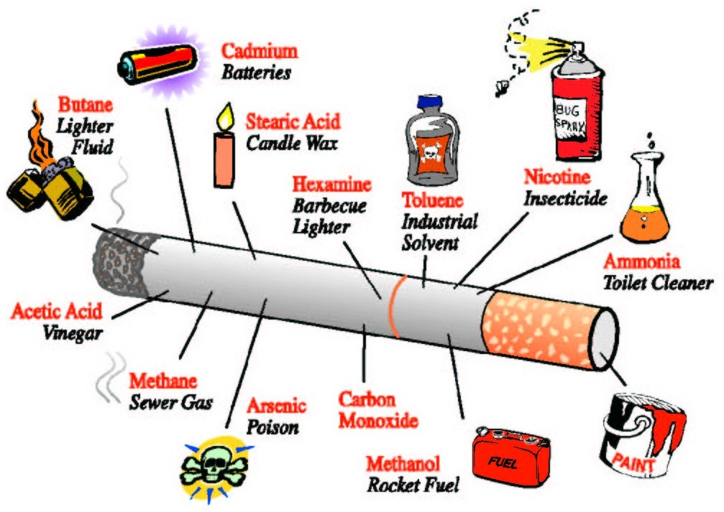
Gas phase:
Contains carbon monoxide, hydrocyanic acid, acetaldehyde, acrolein, ammonia, formaldehyde and oxides of nitrogen, nitrosamines, hydrazine and vinyl chloride.

Slide 6
Cigarette smoke itself may be broken down into two categories of smoke:
Mainstream smoke (MS)
Is that smoke which is inhaled by the smoker from the cigarette during a puff.
Sidestream smoke (SS)
Is that smoke which is emitted by the burning cigarette between puffs.

Slide 7
The chemical compositions of both types of smoke are qualitatively similar since they are both derived from burning tobacco, however, there are some significant quantitative differences between MS and SS. The temperature at which MS is formed is much higher than the temperature at which SS is formed. A result of this is that SS contains larger quantities of many organic chemical compounds than MS. So, SS may be more carcinogenic than MS at the same concentrations.

Slide 8
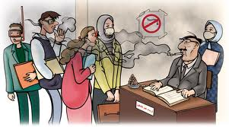
N.B.
Passive smoking is derived mainly from SS.

Slide 9
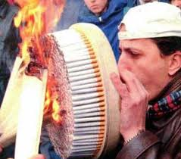
Who is a heavy smoker?
Marrero et al have defined heavy smokers as those exposed to greater than 20 pack-years.
(i.e. smoking index ≥ 400).

Slide 10
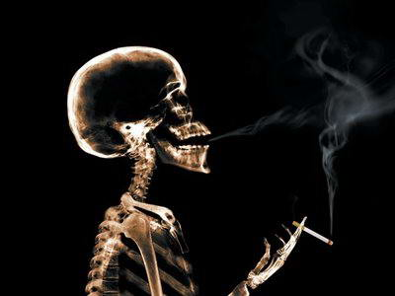
Adverse Effects of Smoking on the Liver

Slide 11
Smoking induces three major adverse effects on the liver:
Toxic effects either direct or indirect.
Immunological effects.
Oncogenic effects.

Slide 12
Toxic effects
1- Direct toxic effect:
Smoking yields chemical substances with cytotoxic potentials. These chemicals induce oxidative stress associated with lipid peroxidation which leads to activation of stellate cells and development of fibrosis. In addition, smoking increases the production of pro-inflammatory cytokines (IL-1, IL-6 and TNF-α) involved in liver cell injury.

Slide 13
It has been reported that smoking increases fibrosis score and histological activity index in chronic hepatitis C (CHC) patients and contributes to progression of HBV-related cirrhosis.

Slide 14
2- Indirect toxic effects (concomitant polycythemia):
Heavy smoking is associated with increased
carboxyhaemoglobin and decreased oxygen carrying
capacity of red blood cells (RBCs) leading to tissue
hypoxia. Hypoxia stimulates erythropoetien production
which induces hyperplasia of the bone marrow. The latter contributes to the development of secondary polycythemia and in turn to increased red cell mass

Slide 15
and turnover. This increases catabolic iron derived from both senescent red blood cells and iron derived from increased destruction of red cells associated with polycythemia. Furthermore, erythropoietin stimulates absorption of iron from the intestine. Both excess catabolic iron and increased iron absorption ultimately lead to its accumulation in macrophages and subsequently in hepatocytes over time, promoting oxidative stress of hepatocytes.

Slide 16
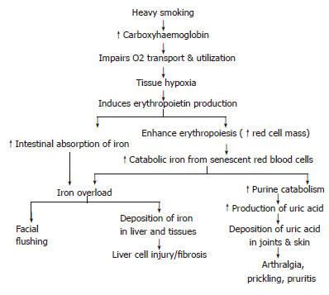
Accordingly, smoking might be a contributing factor to secondary iron overload disease.

Slide 17
B) Immunological Effects
Smoking affects both cell-mediated and humoral immune responses.
Nicotine blocks lymphocyte proliferation and
differentiation including suppression of antibody-forming cells.
Induction of apoptosis of lymphocytes by enhancing expression of Fas (CD95) death receptor.

Slide 18
Induction of elevation of CD8 T-cytotoxic lymphocytes, decreased CD4 cells and impaired NK cell activity.
Increases the production of pro- inflammatory cytokines (IL-1, IL-6, TNF-α).
Cessation of smoking reversed the previously mentioned effects.

Slide 19
C) Oncogenic effects
Cigarette smoke is classified as a group A carcinogen.
Major carcinogens in cigarette smoke are:
Polycyclic aromatic hydrocarbons (PAH).
Nitrosamine.
Vinyl chloride.
Aromatic amines.
Tar.
Trace elements ( As, Cd, Ni and Po²¹⁰).

Slide 20
Cigarette smoking is a major source of
4-aminobiphenyl, a hepatic carcinogen which has been implicated as a causal risk factor for HCC.
Nicotine and tar suppress T-cell responses with decreased surveillance for tumour cells.
Smoking is associated with reduction of the tumour suppressor gene p53.

Slide 21
Heavy smoking leads to accumulation of excess iron in hepatocytes which induces fibrosis and favours development of HCC.
Smoking increases the risk of HCC in patients with viral hepatitis.
Recent data from China and Taiwan have shown an association of smoking with liver cancer independent of HBV status.

Slide 22
Smoking and the Response to IFN Therapy Among Chronic Hepatitis C Patients

Slide 23
Heavy smokers suffering from chronic hepatitis C tend to have a lower response rate to IFN therapy.
Mechanisms:
Immunosuppresion.
Hepatic iron overload.
Induction of pro-inflammatory cytokines (IL-1, IL-6, TNF-α) which mediates necroinflammation and steatosis.
Direct modification of IFN-α-activated cell signaling and action.

Slide 24
Thank you

